Slide 1
Chen Song
- PhD in International Political Economy
- Master in Information Science
(412) 932–3877
chensong5225@gmail.com
http://www.linkedin.com/in/chensong5225
Notes:
Hi! My name is Chen Song. I’m a PhD in international political economy. Also I have a master degree in information science.

Slide 2
A Search Engine of Healthy Recipes
Chen Song
Notes:
Today I want to introduce my project: a search engine of healthy recipes.

Slide 3
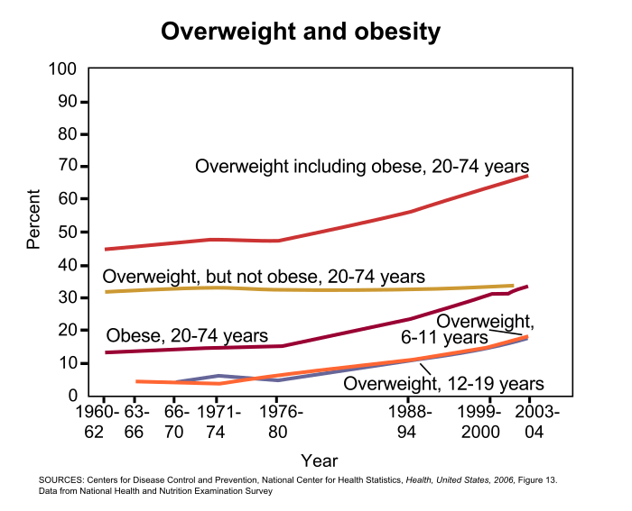
Notes:
Cooking and Eating healthier are very important needs today. According to Wikipedia, there are over 60% of adults and 15% of children in the US are overweight.
On the other side, the American diet is said to be increasingly energy-rich but nutrient-poor. Under this situation, there is a belief that cooking from fresh ingredients at home is a much healthier way of eating.

Slide 4

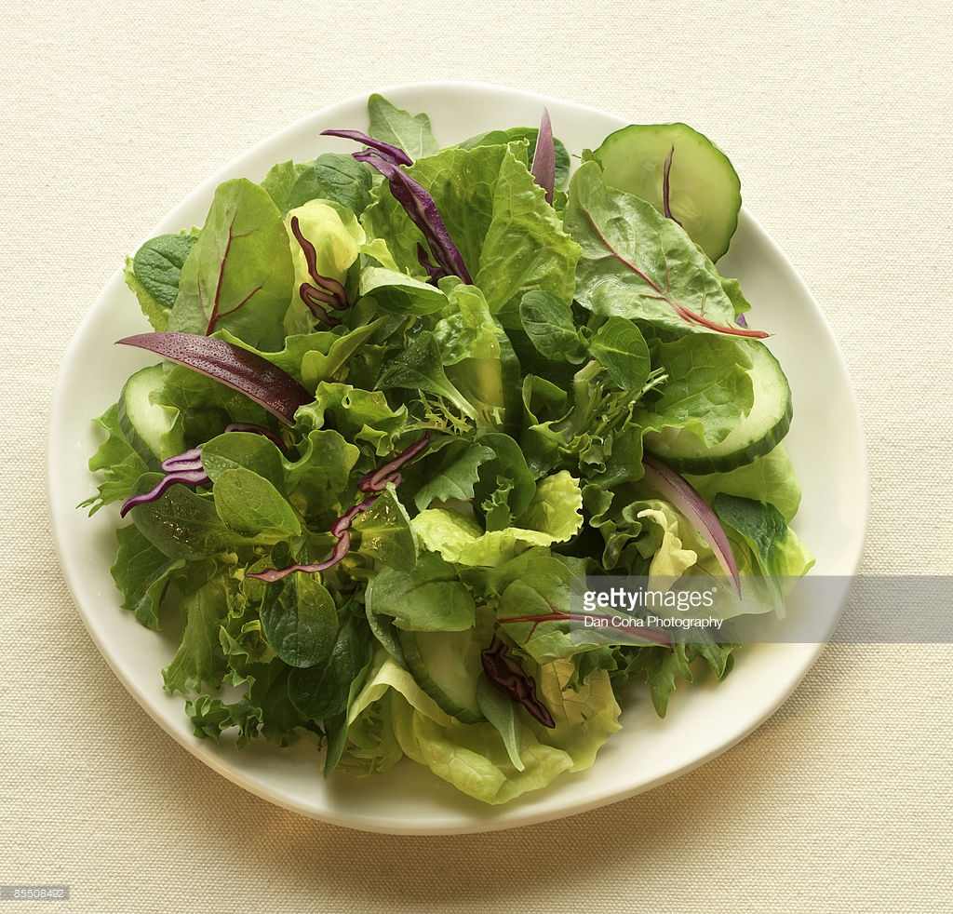
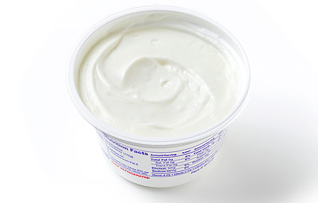

HEALTHY
FOOD
Notes:
But healthy food could be boring: green salad, chicken breast, no-fat yogurt… My kid definitely cannot live on these recipes whatever, me either. How can we find tasty recipes but in a healthier way? This is why I want to build a search engine for healthy recipes at the very beginning.

Slide 5
Project Target:
A search engine which can recommend recipes based on:
Search query
Healthy index
User’s preference
Notes:
The target of my project is to build a search engine which can search recipes based on three things: the search query, a healthy index, and the user’s preference

Slide 6
Data Collection
Got 35K recipes from epicurious.com.
About 10% of them were labeled as "Healthy" by epicurious editors.
Data Analysis
Find the relationship between "Healthy" and numerical features: rating & nutrition information
Natural Language Processing
Find the relationship between "Healthy" and text features: ingredients, steps...
Implement the Search Engine
Embed the result of data analysis and NLP into a search engine

Slide 7
Data Collection
Got 35K recipes from epicurious.com.
About 10% of them were labeled as "Healthy" by epicurious editors.
Data Analysis
Find the relationship between "Healthy" and numerical features: rating & nutrition information
Natural Language Processing
Find the relationship between "Healthy" and text features: ingredients, steps...
Implement the Search Engine
Embed the result of data analysis and NLP into a search engine

Slide 8
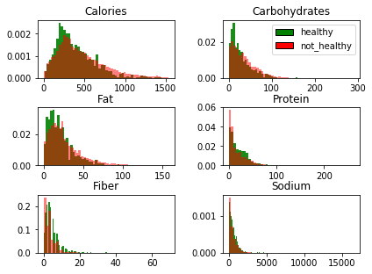
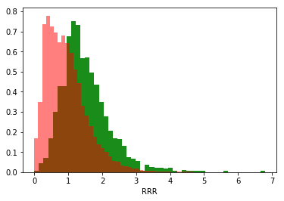
Single Nutrient
Ratio of Recommendation to Restriction
Notes:
After a little bit data exploration, we can see that the numerical features may not be good predictors for healthy. Next I will try to compute some healthy indices using nutrition facts, and more important, introduce natural language processing to do the job.

Slide 9
Data Collection
Got 35K recipes from epicurious.com.
About 10% of them were labeled as "Healthy" by epicurious editors.
Data Analysis
Find the relationship between "Healthy" and numerical features: rating & nutrition information
Natural Language Processing
Find the relationship between "Healthy" and text features: ingredients, steps...
Implement the Search Engine
Embed the result of data analysis and NLP into a search engine

Slide 10
Thank you! Comments & Suggestions, Please!

Slide 11
Data Collection
Got 35K recipes from epicurious.com.
About 10% of them were labeled as "Healthy" by epicurious editors.
Data Analysis
Find the relationship between "Healthy" and numerical features: rating & nutrition information
Natural Language Processing
Find the relationship between "Healthy" and text features: ingredients, steps...
Implement the Search Engine
Embed the result of data analysis and NLP into a search engine

Slide 12

Screen Shot: Main page

Slide 13
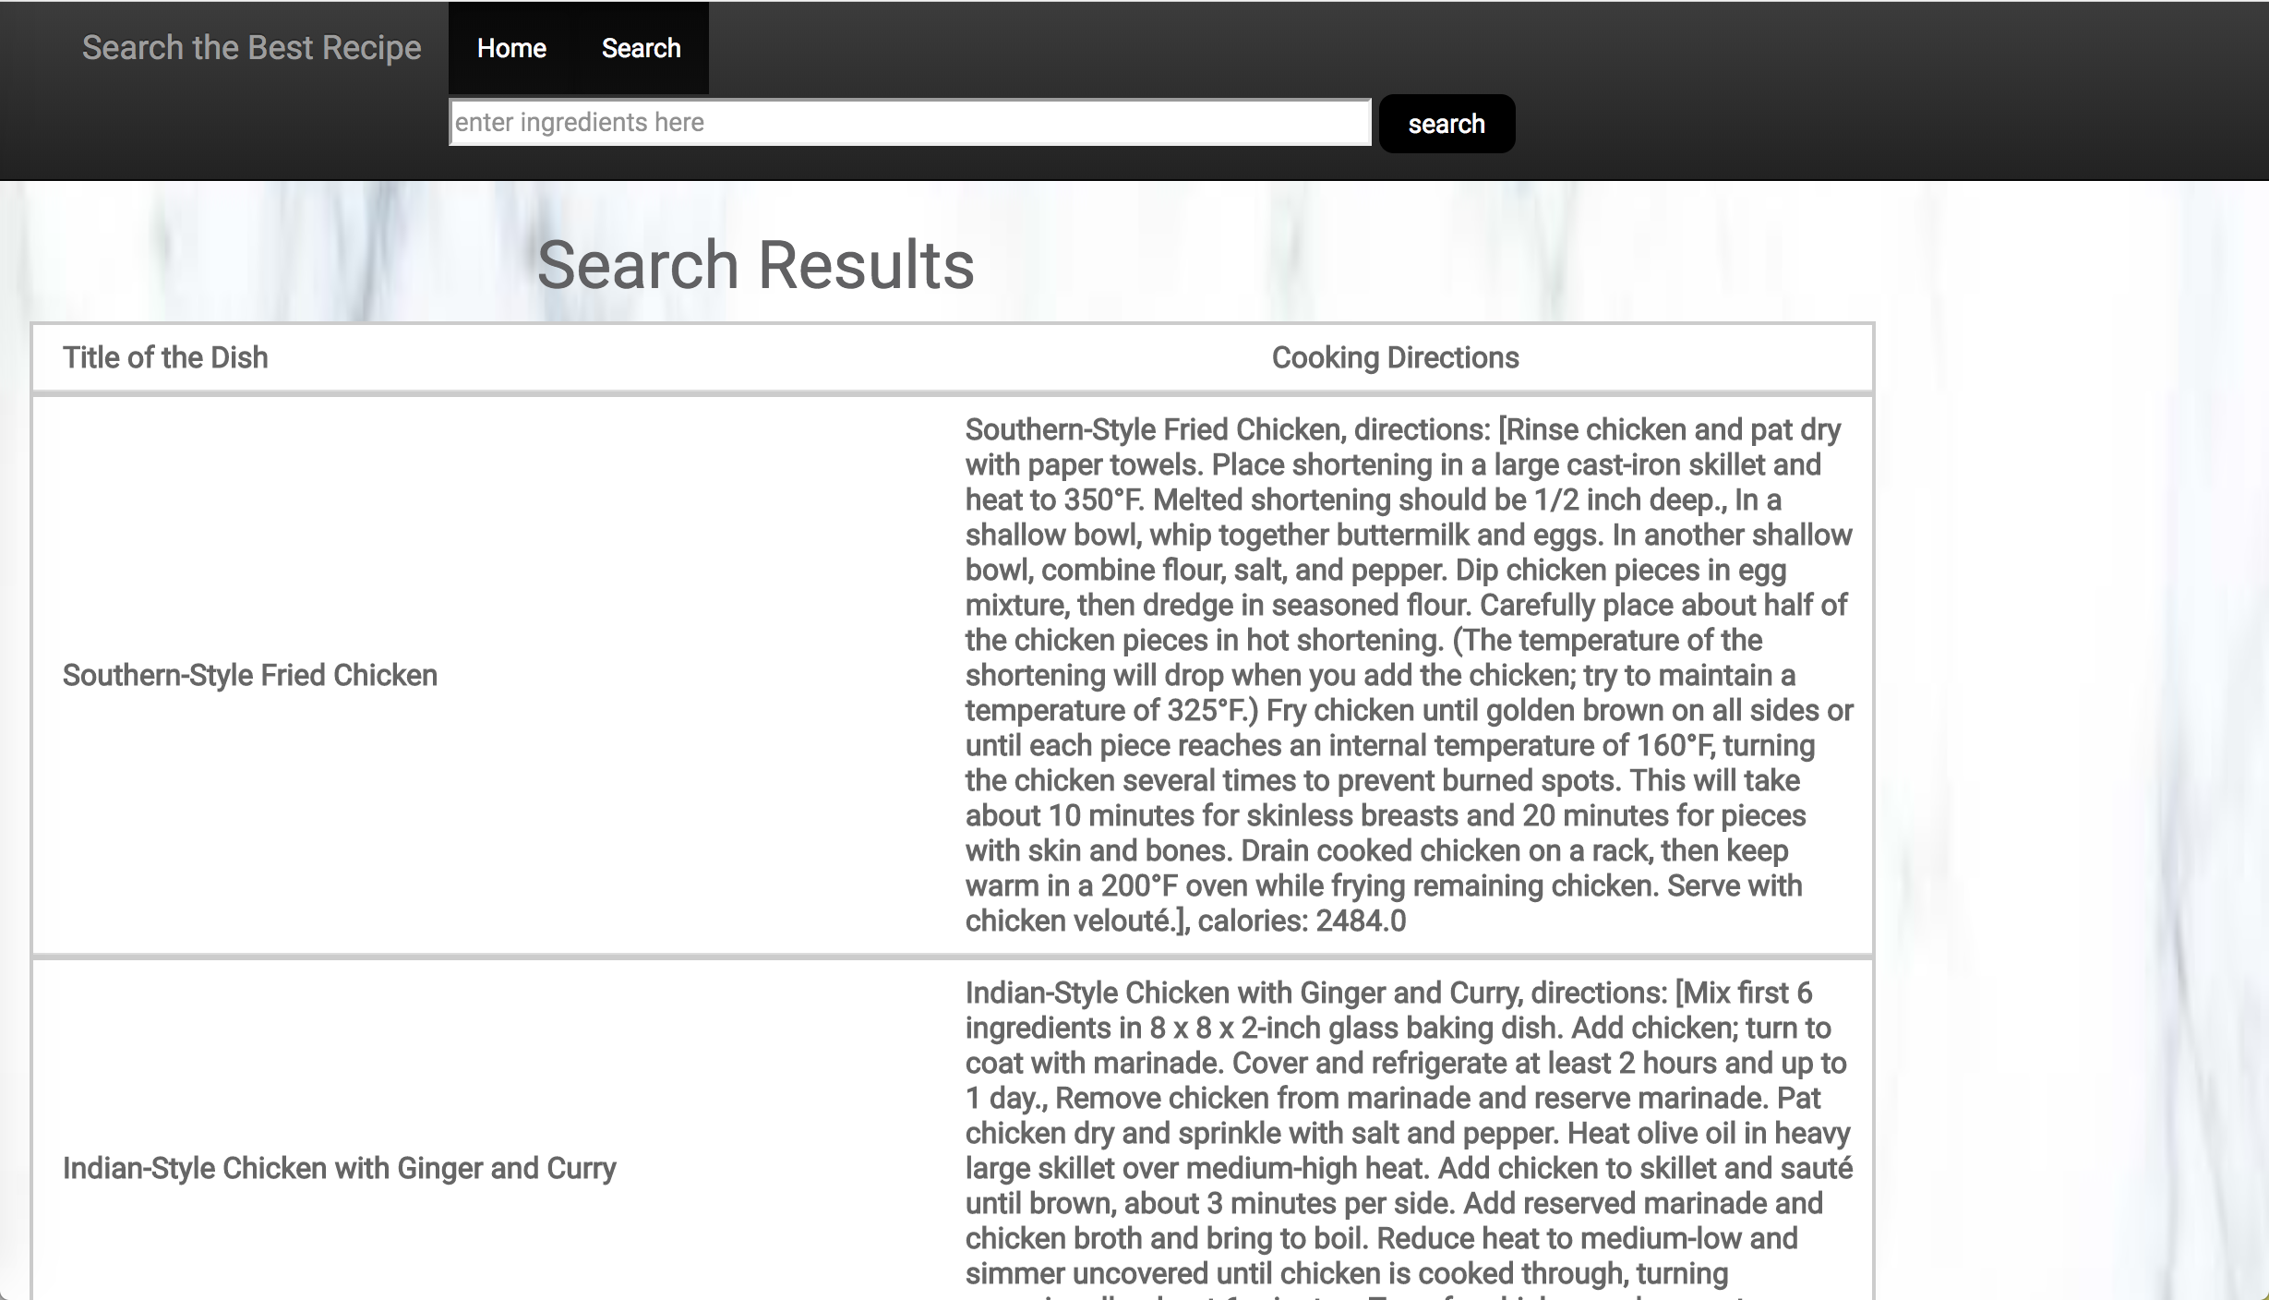
Screen Shot: Search result page

Slide 14
Screen Shot: Recipe detail page

Slide 15
For Demo, please click this link: http://heroku...

Slide 16

Thanks!

